Slide 1

Application for calculating alcohol per specific weight
БухКалькулятор

Slide 2
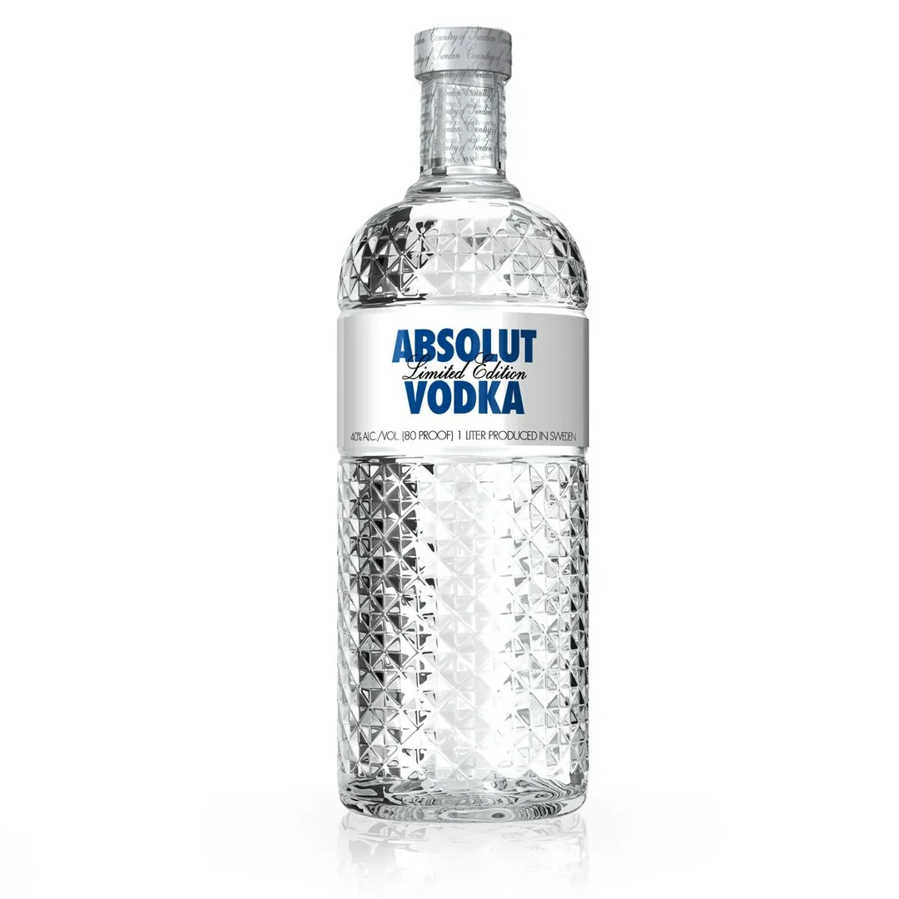
This is the logo of our “БухКалькулятор”

Slide 3
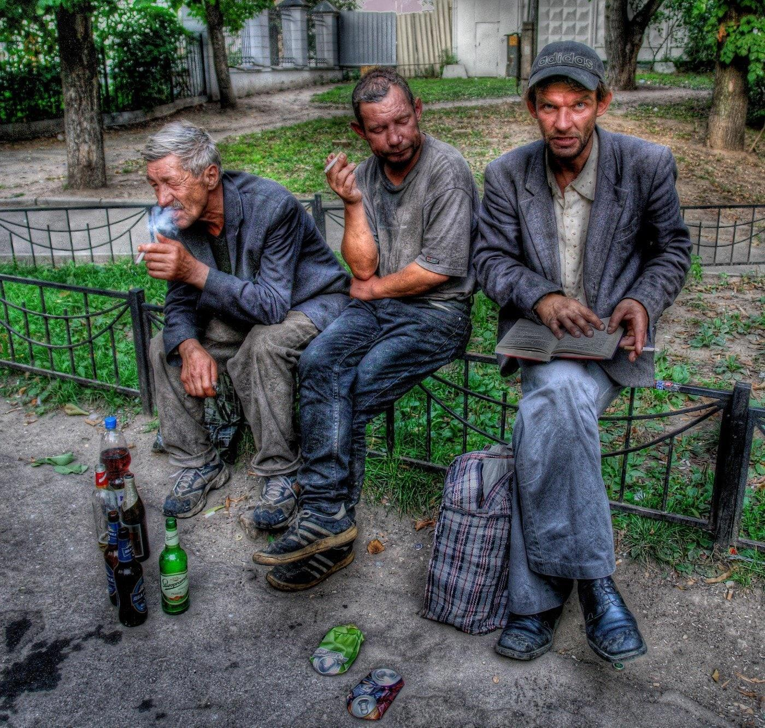
Our app is designed for all age groups in Russia from 11 to 125 years old
You don't want to be a pig? Count the alcohol

Slide 4
1. Main functions
🔢 Dosage calculator - how much you can drink without getting drunk (or as drunk as you need to be).
⏱️ Alcohol Withdrawal Timer - how long before you can drive or go to work.
📊 Intoxication/sobriety graph - visualization of how alcohol is eliminated from the body.
2. Fun and practical chips
🎲 “Excuse Generator” - if you've had too much to drink, the app will come up with a plausible reason why you're not at work/study.
🤪 “Sobriety Test” - mini-games (like “get your finger in your nose” or “say a cursive”) to test how drunk you are.
🍻 “Alco-quiz” - a quiz with questions that are difficult to solve when you're drunk (a test of adequacy).
3. Social and safety features
🚗 “Call a cab” - integration with services if the app sees you're not fit to drive.
📱 “Emergency contact” - sending a notification to a friend if the user is “over the limit”.
🗺️ “Where is the morning waiting for me?” - The ability to write down the party's address so you don't have to search for “where am I even” later.
4. Personalization
🎭 “Daily Mode” - calculating how alcohol will affect sleep, gym or morning plans.
🍷 “Cocktail for your weight” - drink recommendations and safe doses.
📉 “Personal Alcohol Assistant” - analyzing habits and tips on how to drink less.
5. For special occasions
🎉 “Holiday Mode” - calculation of alcohol per company (how many bottles to take for N guests).
🍔 “Snackometer” - what is the best snack to get less drunk.

Slide 5
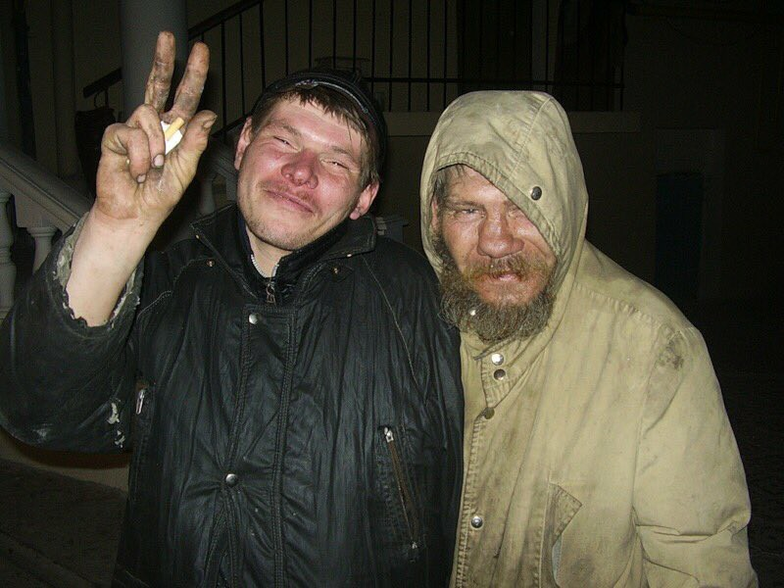
This is us without the calculator.
Thank you for your attention

